Slide 1
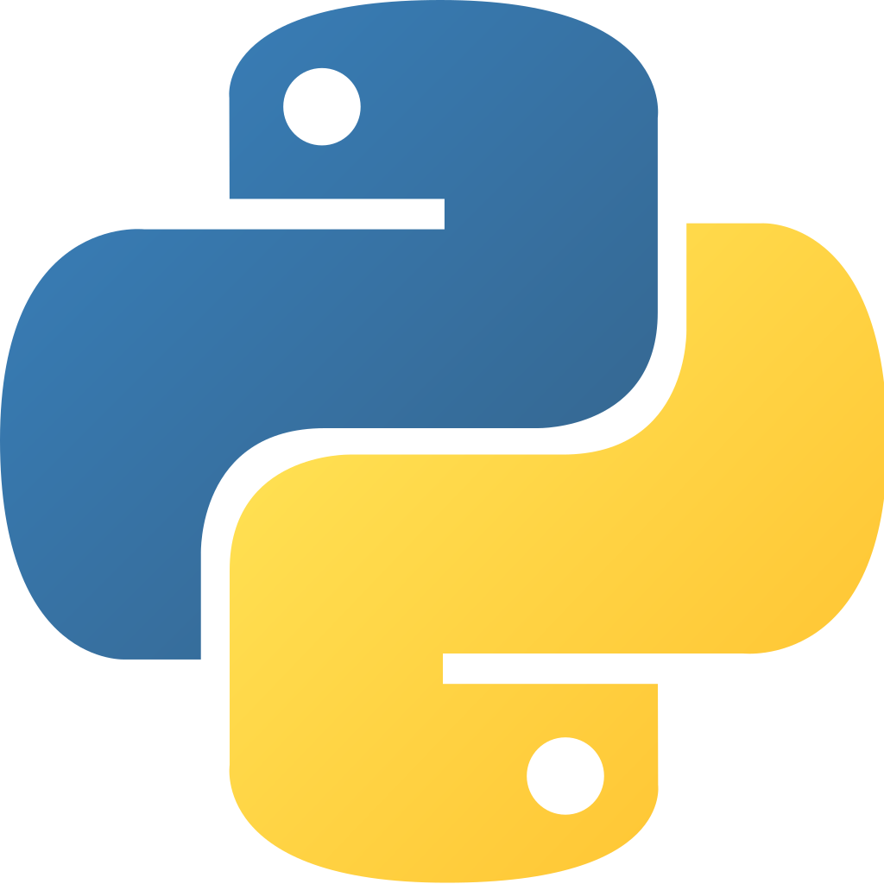
Python for Data Analysis
INNOMATICS RESEARCH LABS

Slide 2

About me
Background ? (B-tech or M-tech)
Why you want to learn Data Science
Any work experience
What like you about Innomatics Research lab
Gudipalle Amar

Slide 3
Agenda
What is data science
Why we need data science
Lifecycle of data science
Why learn python for Data science
Python history
My project with web scraping

Slide 4
What is Data science
Data science is a multi-disciplinary field that uses scientific methods, processes, algorithms and systems to extract knowledge and insights from structured and unstructured data.

Slide 5
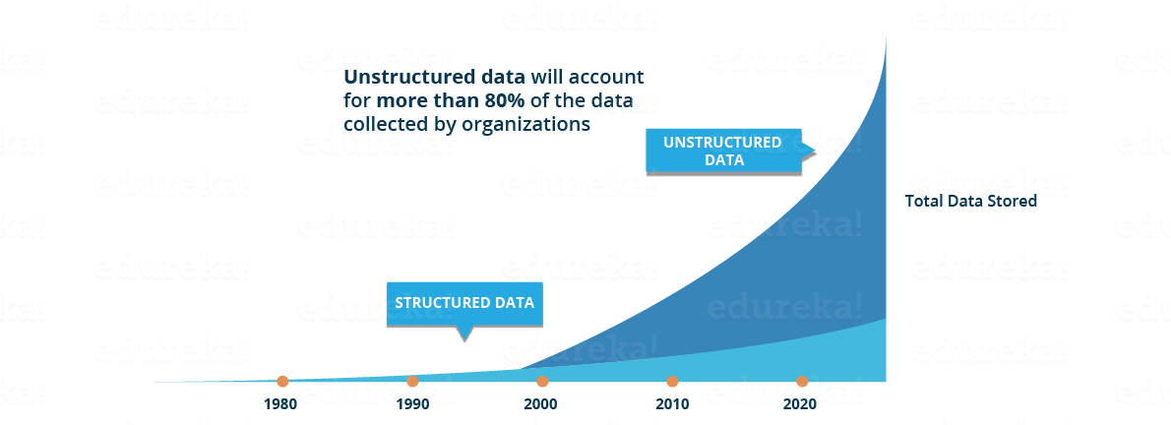
Why we need data science
Traditionally, the data that we used to have was mostly structured and small in size, which could be analysed by using the simple BI tools.
Today most of the data is unstructured or semi-structured. Let’s have a look at the data trends in the image given below which shows that by 2020, more than 80 % of the data will be unstructured.

Slide 6
Why we need data science
This data is generated from different sources like financial logs, text files, multimedia forms, sensors, and instruments.
Simple BI tools are not capable of processing this huge volume and variety of data. This is why we need more complex and advanced analytical tools and algorithms for processing, analysing.

Slide 7
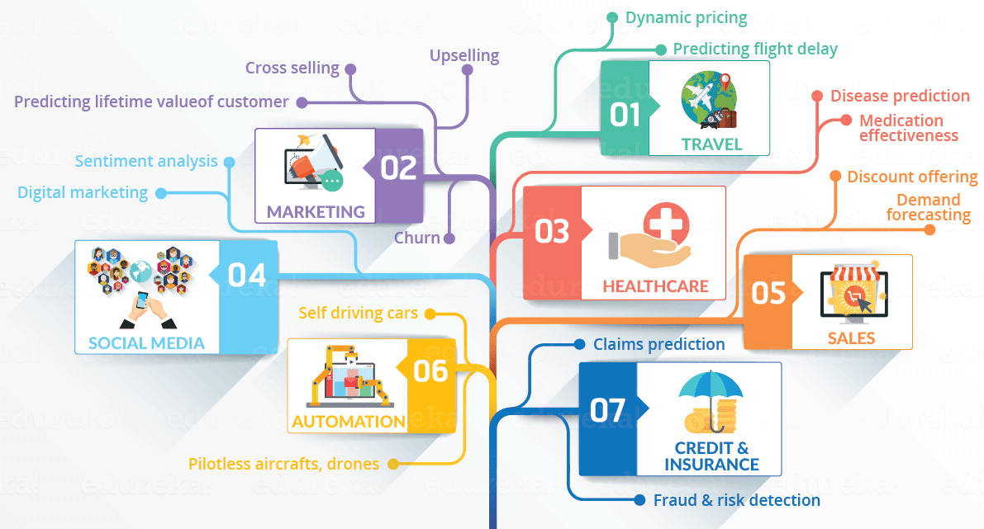
Let’s have a look at the below infographic to see all the domains where Data Science is creating its impression.
What is Data science

Slide 8
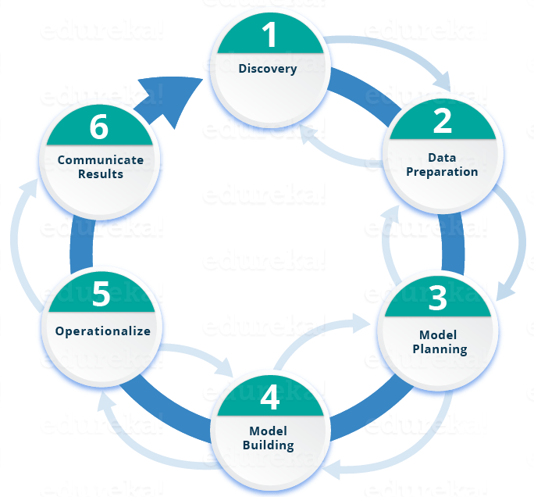
Lifecycle of a Data science
1.Discovery: Before you begin the project, it is important to understand the various specifications, requirements, priorities and required budget. You must possess the ability to ask the right questions.
2.Data preparation: Further, you will perform ETLT (extract, transform, load and transform) to get data
3.Model planning: You will apply Exploratory Data Analytics (EDA) using various statistical formulas and visualization tools.
4.Model building: In this phase, you will develop datasets for training and testing purposes.
5.Operationalize: In this phase, you deliver final reports, briefings, code and technical documents.
6.Communicate results: communicate to the stakeholders and determine if the results of the project are a success or a failure based on the criteria developed in Phase 1.

Slide 9
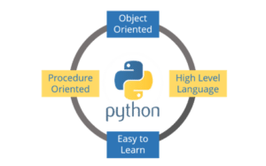
Why Learn Python For Data Science?
Python is no-doubt the best-suited language for a Data Scientist.
1.Python is a free, flexible and powerful open source language
2.Python cuts development time in half with its simple and easy to read syntax
3.With Python, you can perform data manipulation, analysis, and visualization
4.Python provides powerful libraries for Machine learning applications and other scientific computations

Slide 10
History of Python
Python was created by Guido Van Rossum in 1989.
Why is it called Python? When he began implementing Python, Guido van Rossum was also reading the published scripts from “Monty Python's Flying Circus”, a BBC comedy series from the 1970s. Van Rossum thought he needed a name that was short, unique, and slightly mysterious, so he decided to call the language Python.

Slide 11
Now let start with the project on web scrapping

Slide 12
What/Why is Web scrapping
Web scraping is a term used to describe the use of a program or algorithm to extract and process large amounts of data from the web.
Let's say you find data from the web, and there is no direct way to download it, web scraping using Python is a skill you can use to extract the data into a useful form that can be imported.

Slide 13
In this project of web scraping • Data extraction from the web using Python's Beautiful Soup module • Data manipulation and cleaning using Python's Pandas library • Data visualization using Python's Matplotlib library

Slide 14
Specifically, I had analyzed the performance of the 10K runners and I will answer the below questions such as: • What was the average finish time for the runners? • Did the runners' finish times follow a normal distribution? • Comparison of average minutes run by male and female • Summary statistics for males and females.

Slide 15
Conclusion: 1.In this project I performed web scraping using Python. 2.Used the Beautiful Soup library to extract html data and convert it into a form that can be used for analysis. 3.Performed cleaning of the data in Python and created useful plots (box plots, bar plots, and distribution plots) to reveal interesting trends using Python's matplotlib and seaborn libraries

Slide 16
Any Queries

Slide 17
THANK YOU!
For your patience

